Slide 1
Solid State Drive
SSD

Slide 2
What is SSD?
SSD stands for Solid State Drive.
It is similar like a USB memory sticks - SSD can be thought of as an oversized and more sophisticated version of the humble USB memory stick.
In SSD there are no moving parts to store information in microchips.
SSD is so much faster as HDD needs a mechanical arm with a read/write head to move around and read information from the right location on a storage platter.
It uses NAND-based flash memory or non-volatile type memory.

Slide 3
Data Storing Process
An SSD has embedded processor (or “brain”) called a controller to perform a bunch of operations related to reading and writing data.
The controller is a very important factor for determining the speed of the SSD, making decisions related to data storing time, retrieve, cache and clean up data.

Slide 4
Difference Between SSD & HDD
SSD | HDD
1. Less power draw, averages 2 – 3 watts, resulting in 30+ minute battery boost | 1. More power draw, averages 6 – 7 watts and therefore uses more battery
2. Expensive | 2. Very cheap
3. There is no moving parts to store data | 3. Need mechanical arm to rotate the storage platter
4. Typically not larger than 1TB for notebook size drives; 4TB max for desktops | 4. Typically around 500GB and 2TB maximum for notebook size drives; 10TB max for desktops
5. Lower power draw and no moving parts so little heat is produced | 5. HDD doesn’t produce much heat, but it will have a measurable amount more heat than an SSD due to moving parts and higher power draw
6. No noise due to the absence of moving parts. | 6. Audible clicks and spinning can be heard

Slide 5
Difference Between SSD & HDD
SSD | HDD
7. Full Disk Encryption (FDE) Supported on some models | 7. Full Disk Encryption (FDE) Supported on some model
8. Around 10-13 seconds average bootup time | 8. Around 30-40 seconds average bootup time
9. File opening speed is up to 30% faster than HDD | 9. File opening speed is slower than HDD
10. No vibration as there are no moving parts | 10. The spinning of the platters can sometimes result in vibration
11. An SSD is safe from any effects of magnetism | 11. Magnets can erase data.

Slide 6
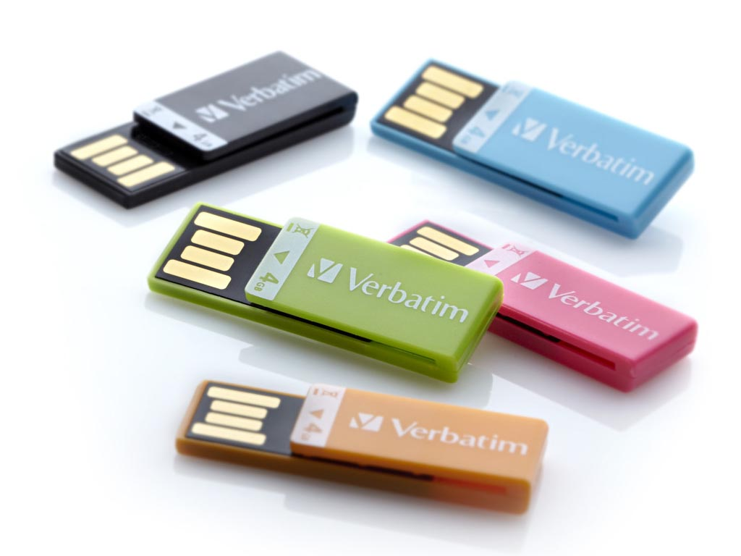
USB Flash Drive
USB flash drive is a data storage device that includes flash memory with an integrated USB interface.
USB flash drives are typically removable and rewritable storage system.
This is used for storage, data back-up and transfer of computer files.

Slide 7
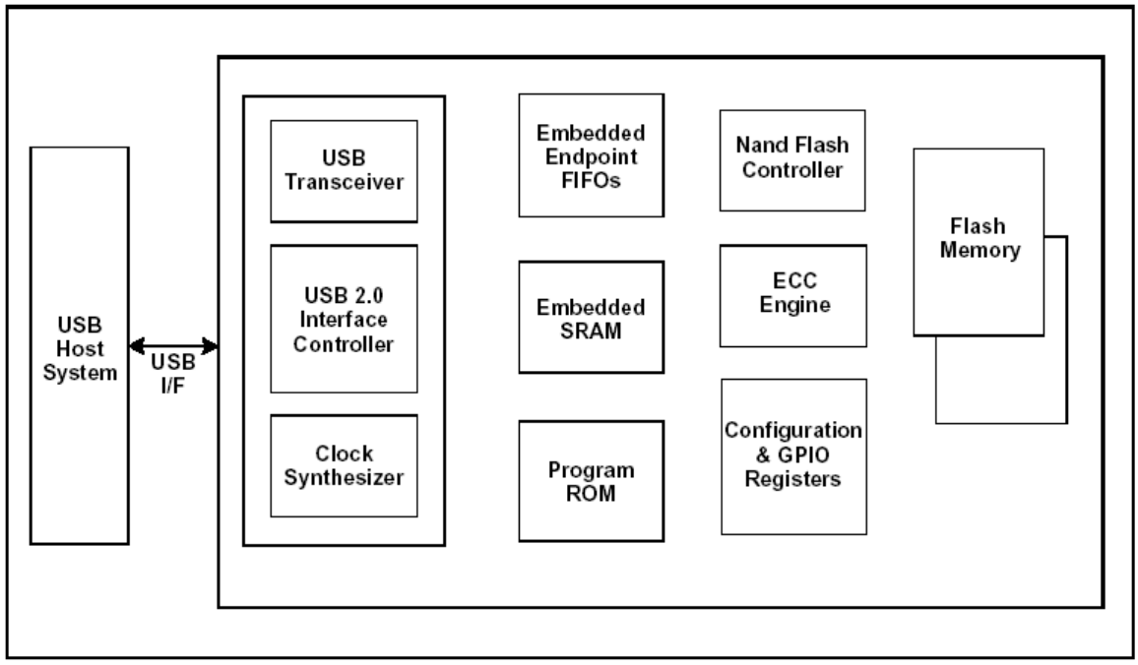
Block Diagram of USB flash drive

